Slide 1
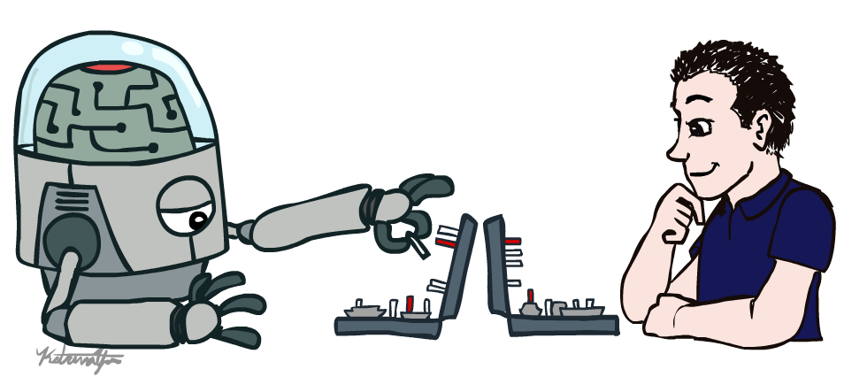
Artificial Intelligence
Introduction
Amit Kumar Das
Lecturer
Dept. of CSE, East West University

Slide 2

Textbook
Russell & Norvig, AI: A Modern Approach, 3rd Ed.

Slide 3
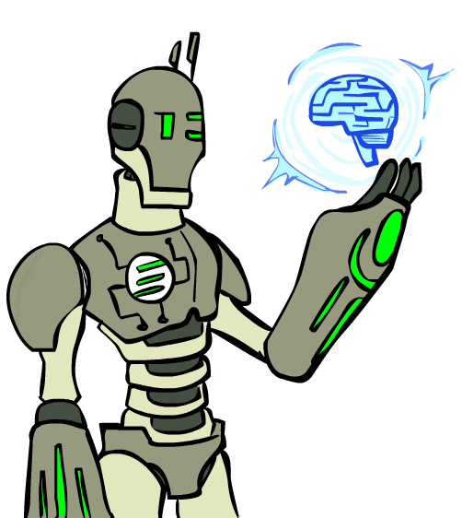
Today
What is artificial intelligence?
Past: how did the ideas in AI come about?
Present: what is the state of the art?
Future: will robots take over the world?

Slide 4
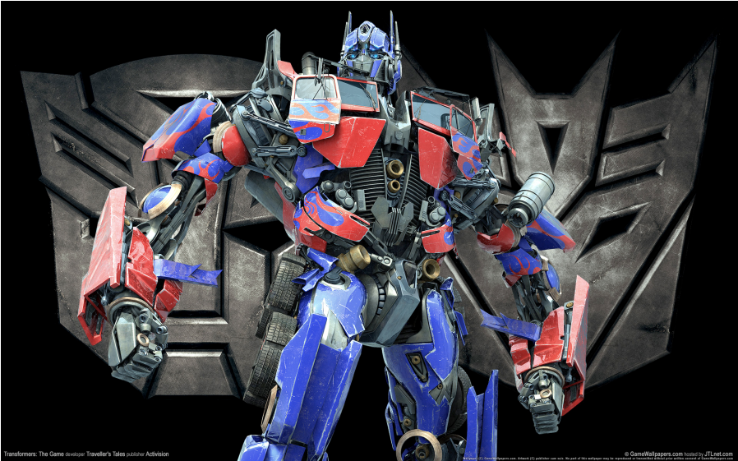
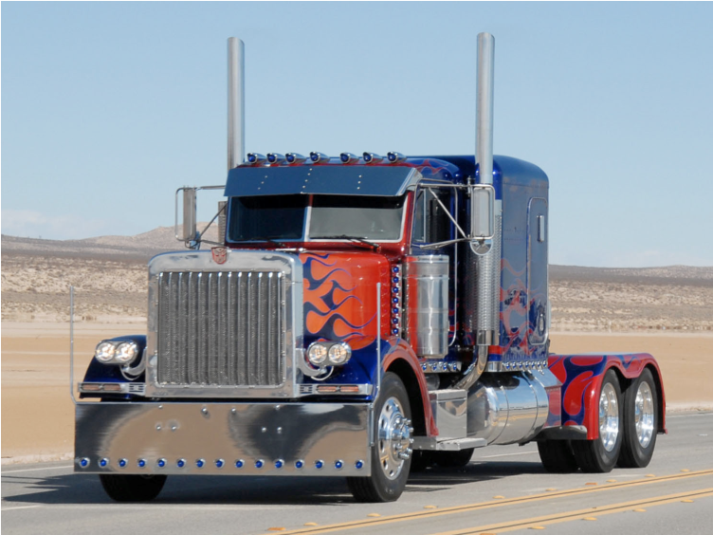
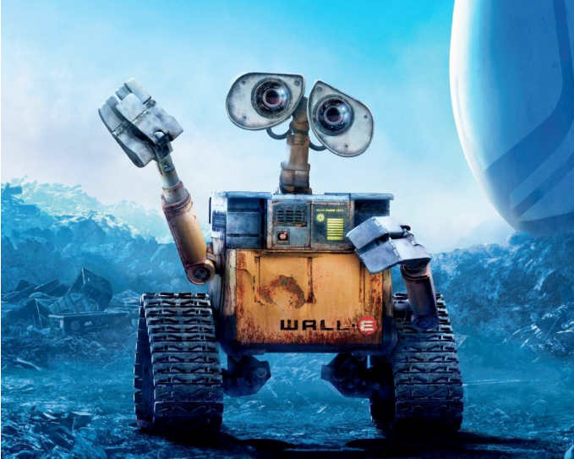
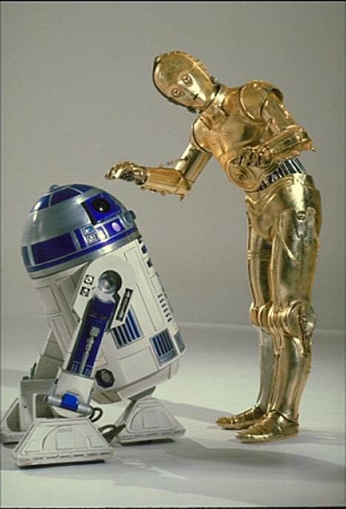
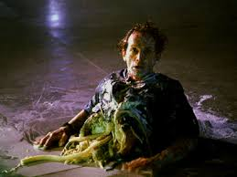
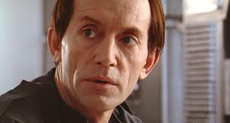
What is AI?
Notes:
Who are these? C3PO, what does he do? Essentially google translate, (but with anxiety disorder!)
Smal guy? R2D2 – what does he do, yeah, not so sure
Things got darker: machines come back from the future – to kill us!
90’s : software is scary
Basic fear about what technology might do ?
What if we can’t even tell technology apart from ourselves?
OR maybe it’ll look really different and snarky
Some exceptions like wall-E, positive view of technology (but maybe not of us humans!)
But mostly a worry
[not very worried myself, at least at present]

Slide 5
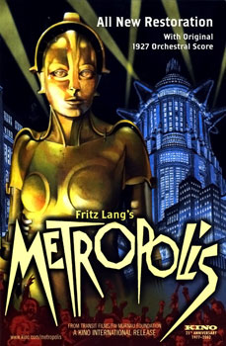
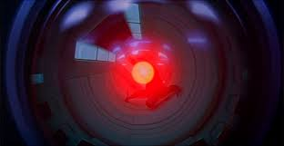
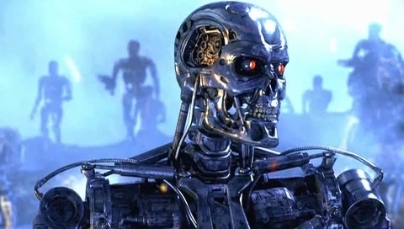
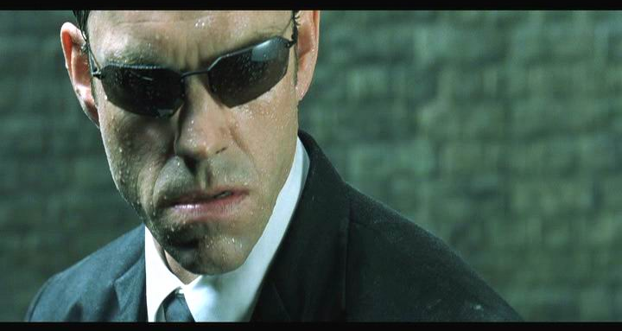
What is AI?

Slide 6
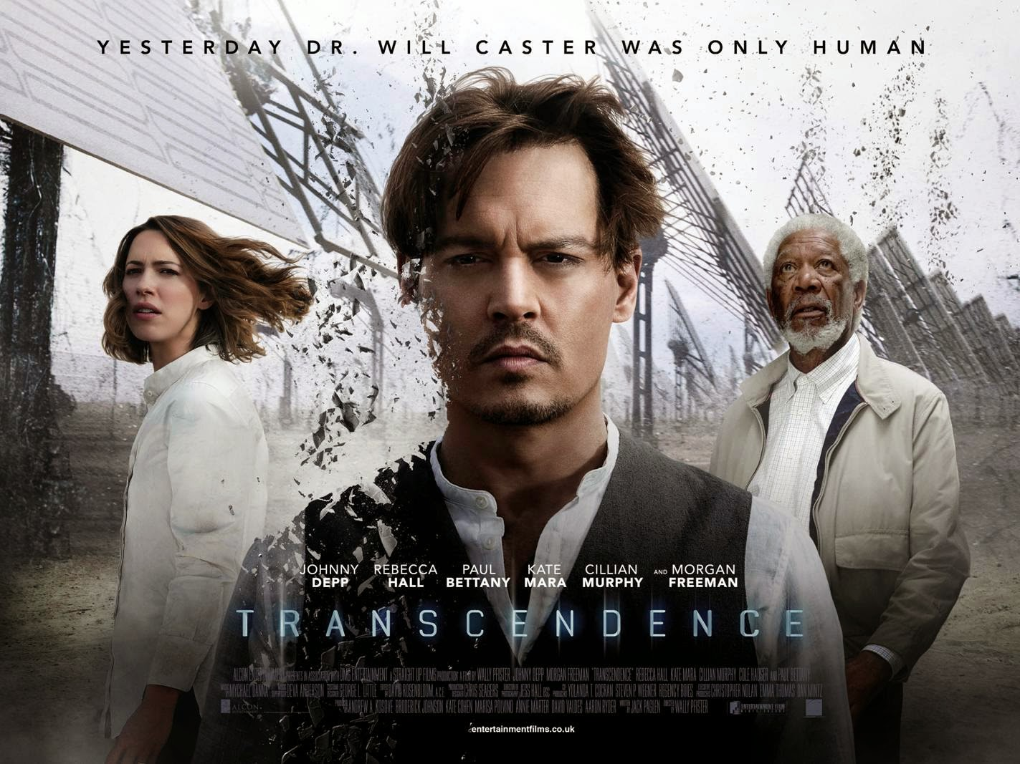

Slide 7
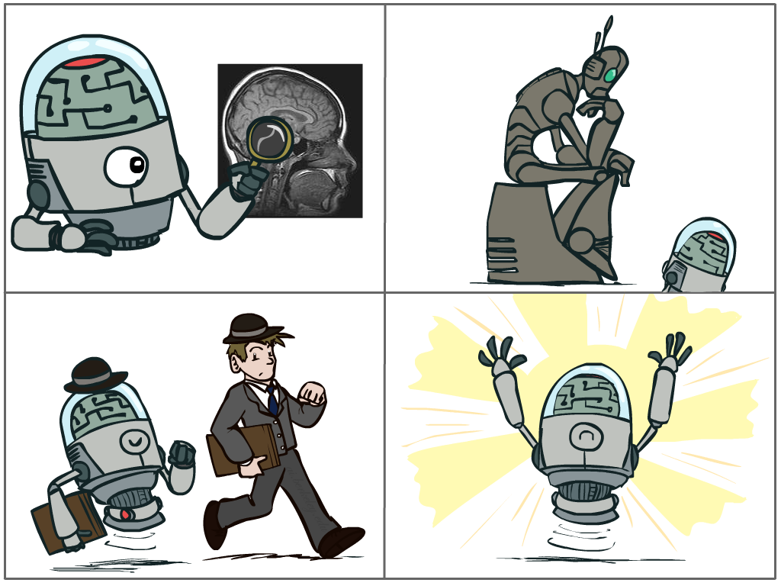
What is AI?
The science of making machines that:
Think like people
Think rationally
Act like people
Act rationally
Notes:
Top left: Think like people --- cognitive science, neuroscience
Bottom left: act like people --- actually very early definition, dating back to Alan Turing --- Turing test; problem to do really well you start focusing on things like don’t answer too quickly what the square root of 1412 is, don’t spell too well, and make sure you have a favorite movie etc. So it wasn’t really leading us to build intelligence
Think rationally – long tradition dating back to Aristotle --- but not a winner, because difficult to encode how to think, and in the end it’s not about how you think, it’s about how you end up acting

Slide 8
What is AI?
To build models of (or replicate) human cognition
Psychology, neuroscience, cognitive science: the brain is tricky
To build useful intelligent artifacts
Engineering
To create and understand intelligence as a general property of systems
Encompasses all of the above
Rationality within computational limitations

Slide 9
Rational Decisions
We’ll use the term rational in a very specific, technical way:
Rational: maximally achieving pre-defined goals given available information
Rationality only concerns what decisions are made
(not the thought process behind them)
Goals are expressed in terms of the utility of outcomes
Being rational means maximizing your expected utility
A better title for this course would be:
Computational Rationality
Notes:
Example of utilities. 10 for A, 1 for each Friday with friends

Slide 10
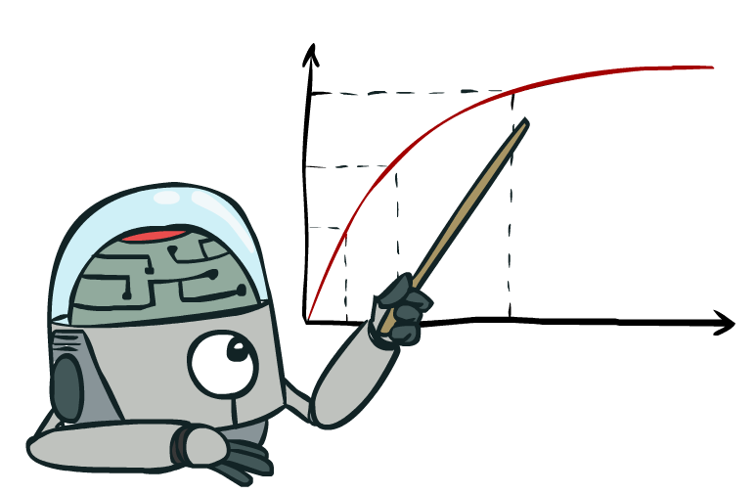
Maximize Your
Expected Utility
Notes:
So here’s some advice:

Slide 11
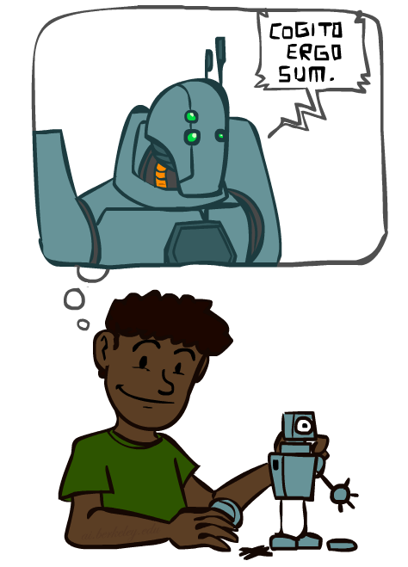
A (Short) History of AI
Demo: HISTORY – MT1950.wmv

Slide 12
A short prehistory of AI
Prehistory:
Philosophy from Aristotle onwards
Mathematics (logic, probability)
Neuroscience (neurons, adaptation)
Economics (rationality, game theory)
Control theory (feedback)
Psychology (learning, cognitive models)

Slide 13
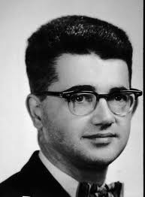
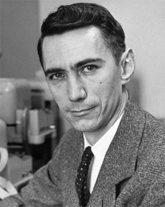
AI’s official birth: Dartmouth, 1956
“An attempt will be made to find how to make machines use language, form abstractions and concepts, solve kinds of problems now reserved for humans, and improve themselves. We think that a significant advance can be made if we work on it together for a summer.”
John McCarthy and Claude Shannon
Dartmouth Workshop Proposal

Slide 14
A (Short) History of AI
1940-1950: Early days
1943: McCulloch & Pitts: Boolean circuit model of brain
1950: Turing's “Computing Machinery and Intelligence”
1950—70: Excitement: Look, Ma, no hands!
1950s: Early AI programs, including Samuel's checkers program, Newell & Simon's Logic Theorist, Gelernter's Geometry Engine
1956: Dartmouth meeting: “Artificial Intelligence” adopted
1965: Robinson's complete algorithm for logical reasoning
1966-9: Failure of naïve MT and learning methods
1970—90: Knowledge-based approaches
1969—79: Early development of knowledge-based systems
1980—88: Expert systems industry booms
1988—93: Expert systems industry busts: “AI Winter”
1990—: Statistical approaches
Resurgence of probability, focus on uncertainty
General increase in technical depth
Agents and learning systems… “AI Spring”?
2000—: Where are we now?
Notes:
Million dollar computer with less computation than your phone
MT was

Slide 15
Unintentionally Funny Stories
Once upon a time there was a dishonest fox and a vain crow. One day the crow was sitting in his tree, holding a piece of cheese in his mouth. He noticed that he was holding the piece of cheese. He became hungry, and swallowed the cheese. The fox walked over to the crow. The End.
[Shank, Tale-Spin System, 1984]
Notes:
1 – physically wrong, shouldn’t eat beehive
2 – forgot that in drowning not the force is most important but the drownee
3 – not physically wrong, not wrong in a language way, but wrong in the sense that it’s not aware of what is relevant to communicate and what is not
Siri – is that progress?

Slide 16
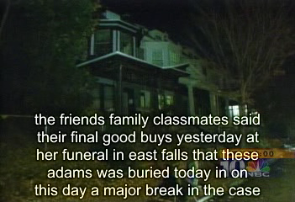
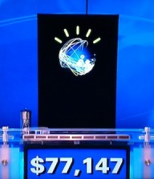
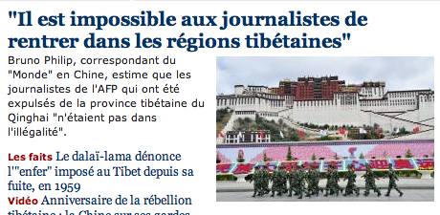
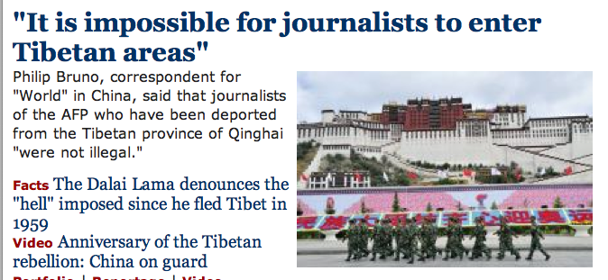
Natural Language
Speech technologies (e.g. Siri)
Automatic speech recognition (ASR)
Text-to-speech synthesis (TTS)
Dialog systems
Language processing technologies
Question answering
Machine translation
Web search
Text classification, spam filtering, etc…
Notes:
The friends, family, and classmates said their final goodbyes yesterday ay her funeral in East Falls, where Teresa Adams was buried today. And on this day a major break in the case

Slide 17
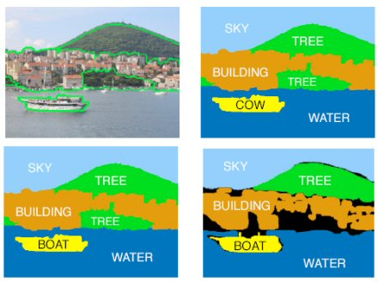
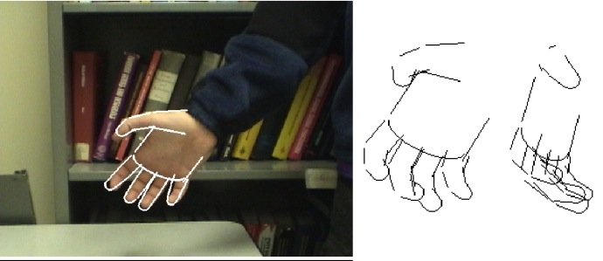
Vision (Perception)
Object and face recognition
Scene segmentation
Image classification
Object tracking and behavior recognition
Images from Erik Sudderth (left), scienceagogo (right)

Slide 18
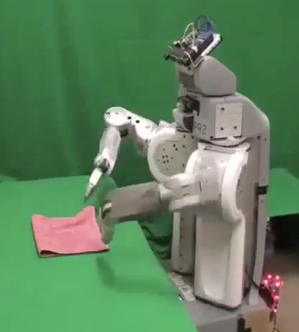
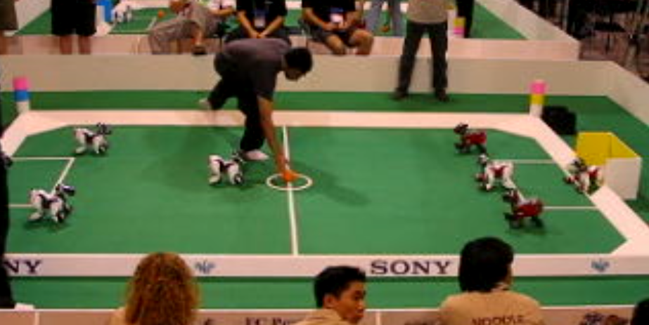
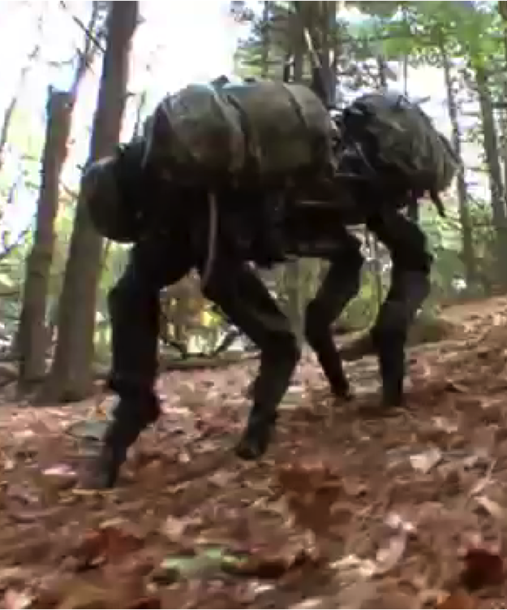
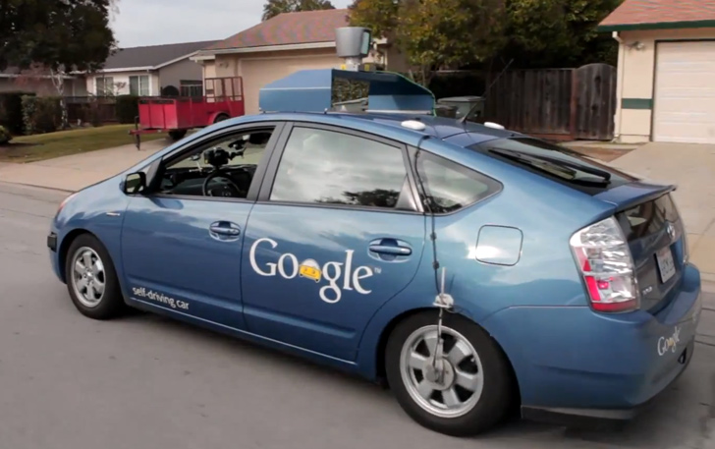
Robotics
Robotics
Part mech. eng.
Part AI
Reality much
harder than
simulations!
Technologies
Vehicles
Rescue
Soccer!
Lots of automation…
In this class:
We ignore mechanical aspects
Methods for planning
Methods for control
Images from UC Berkeley, Boston Dynamics, RoboCup, Google

Slide 19
Logic
Logical systems
Theorem provers
Program and plan synthesis, verification
NASA fault diagnosis
Question answering
Rule-based information systems
Methods:
Deductive inference
Constraint satisfaction
Satisfiability solvers (huge advances!)
Image from Bart Selman

Slide 20
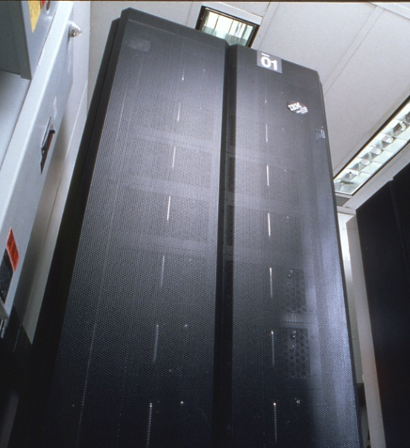
Game Playing
Classic Moment: May, '97: Deep Blue vs. Kasparov
First match won against world champion
“Intelligent, creative” play
Special-purpose hardware, 200 million board positions per second
Current PC programs far ahead of humans
Open question:
How does human cognition deal with the
vast search space of chess?
Or: how can humans compete with computers at all??
1996: Kasparov Beats Deep Blue
“I could feel --- I could smell --- a new kind of intelligence across the table.”
1997: Deep Blue Beats Kasparov
“Deep Blue hasn't proven anything.”
Huge game-playing advances recently, e.g. in Go
Text from Bart Selman, image from IBM’s Deep Blue pages
Notes:
Yeah, Kasparov comment probably says more about humans than about computers.
Current best: Stockfish is around 3285

Slide 21
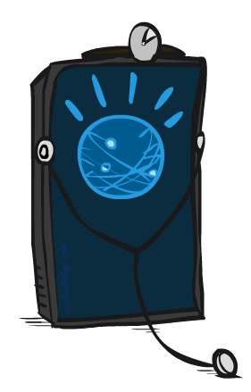
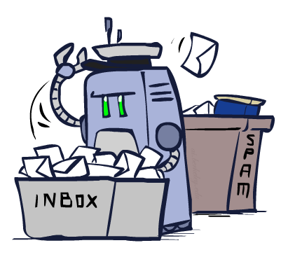
Embedded applications
AI lies behind many other useful systems:
Scheduling, e.g. airline routing, military
Route planning, e.g. Google maps
Medical diagnosis, e.g., EKGs
Automated surveillance
Web search engines
Spam classifiers
Automated help desks
Fraud detection
Product recommendations
… Lots more!
Notes:
All applications can be thought of as decision making or useful sub-components of decision making

Slide 22
Future
We are doing AI…
To create intelligent systems
The more intelligent, the better
To gain a better understanding of human intelligence
To magnify those benefits that flow from it

Slide 23
Future, contd.
Progress is accelerating, partly due to an industry arms race
Once performance reaches a minimum level, every 1% improvement is worth billions
Speech
Text understanding
Object recognition
Automated vehicles
Domestic robots

Slide 24
What if we do succeed?
“The first ultraintelligent machine is the last invention that man need ever make.” I. J. Good, 1965
Might help us avoid war and ecological catastrophes, achieve immortality and expand throughout the universe
Success would be the biggest event in human history …
and perhaps the last

Slide 25
Reasons not to worry
“AI will never reach human levels of intelligence”
“OK, maybe it will, but I’ll be dead before it does”
“Machines will never be conscious”
Consciousness isn’t the problem, it’s competence!
“We design these things, right?”
Yes, and the genie grants three wishes
For almost any goal, a superintelligent system will…
Acquire as many resources as possible and improve its own algorithms
Protect itself against any attempt to switch it off or change the goal

